Slide 1
Principles of the Software Design
Course for Armenian-French University
Areg Melik-Adamyan
Petr Kurapov

Slide 2
Lecture 7
From algorithms to systems – Google's search engine architecture

Slide 3
Agenda

Slide 4
The search problem
People follow a web link graph
Start with some high-quality search list
Extremely large number of web pages to index
Huge ever-growing amount of search requests
Naïve keyword matching usually produces low-quality matches
Web pages attempt to mislead automated search engines to gain people’s attention
People’s ability to look through search results does not scale – need very high precision – relevance.

Slide 5
Web structure
Page relevance is subjective, however there are objective methods to estimate human interest.
Ranking quality for each web page is calculated using the link structure of the Web.
Forward links (outedges) and backlinks (inedges) – B, C, D are backlinks of A.
Highly linked pages are likely more “important”.
A
B
C
D
Notes:
All forward links are known if a page is downloaded
We can never know all the backlinks

Slide 6

PageRank
“A page has high rank if the sum of the ranks of its backlinks is high”.
$$R\left(u\right)=c\sum_{v∈B_{u}}{\frac{R(v)}{\left|F_{v}\right|}}$$
Backlinks(U)
U
Forwardlinks(U)
Notes:
C – normalization factor (<1 since there are pages with no forward links)

Slide 7
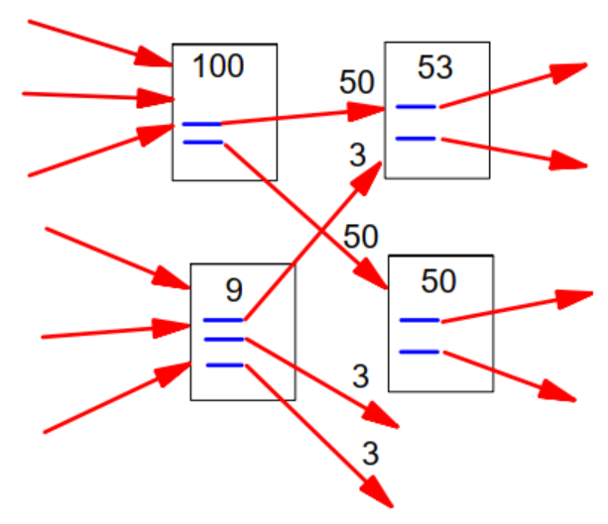
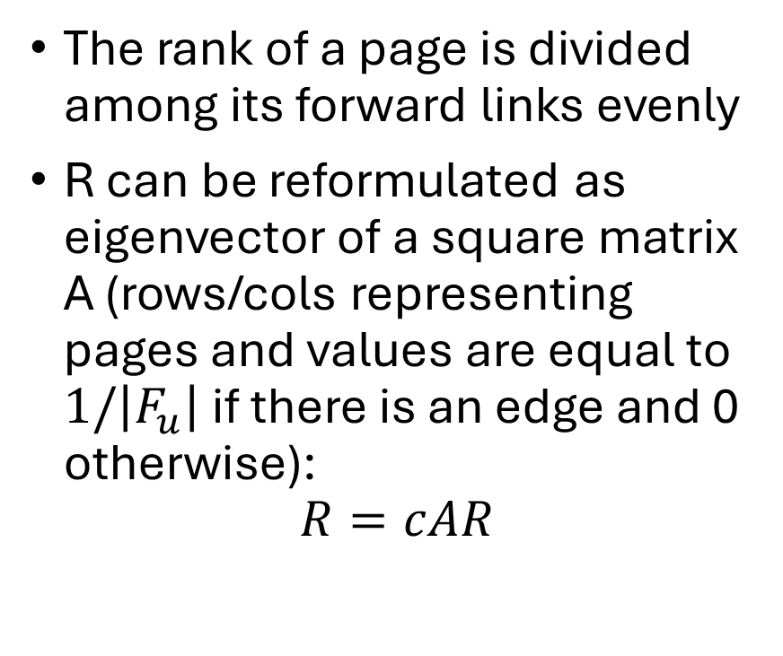
PageRank
The rank of a page is divided among its forward links evenly
R can be reformulated as eigenvector of a square matrix A (rows/cols representing pages and values are equal to $1/\left|F_{u}\right|$ if there is an edge and 0 otherwise):
$$R=cAR$$
Notes:
R – eigenvector with eigenvalue “c”, meaning R can be computed by iteratively applying A to any nondegenerate start vector

Slide 8
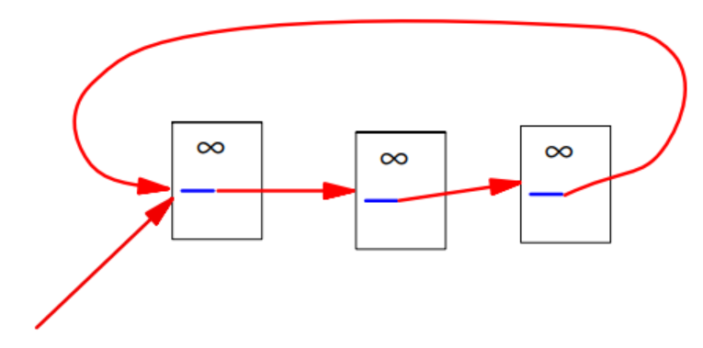
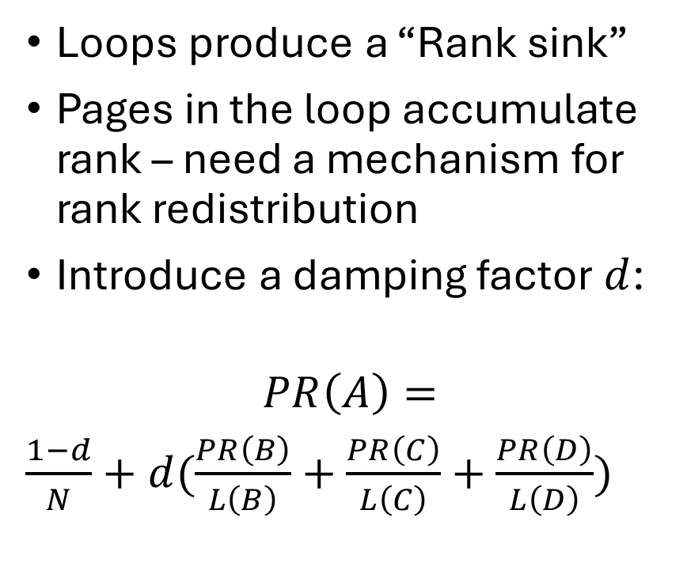
PageRank
Loops produce a “Rank sink”
Pages in the loop accumulate rank – need a mechanism for rank redistribution
Introduce a damping factor $d$:
$$PR\left(A\right)=$$
$\frac{1−d}{N}+d(\frac{PR\left(B\right)}{L\left(B\right)}+\frac{PR\left(C\right)}{L\left(C\right)}+\frac{PR\left(D\right)}{L\left(D\right)})$
A
B
C
D
Notes:
Pageranks form a probability distribution over web pages – sum of all is 1.
Markov chain – random surfer & empirical d = 0.85 – probability of a random surfer to get bored.

Slide 9
Google architecture overview
Store server
Crawler
URL server
Crawler
Crawler
Repository
Indexer
Anchors
URL resolver
Lexicon
Barrels
Links
Doc index
Sorter
Sorter
Sorter
PageRank
Searcher
Notes:
URL server sends lists of URLs to crawlers
Web crawling by distributed crawlers
Fetched pages sent to store server – compression & store to repo by docID
Indexing by indexer and sorter
Indexer reads pages from repo and parses them – docs converted to set of word occurrences – “hits” (word, position in doc, font, size, capitalization)
Hits are distributed into barrels – partially sorted forward index
Indexer parses and stores links into an anchor file (from, to, text of the link)
URL resolver reads anchors, converts relative urls to absolute into docID; put text into forward index
Resolver generates links – pairs of docIDs
Pagerank computes ranking from the links db
Sorter creates inverted index (from docID to wordID)
Dumplexicon util takes inverted index and lexicon from indexer and produces new lexicon for the searcher
Searcher is run be a web server and uses the lexicon, inverted index and pageranks to answer queries

